Slide 1

Modern Database Management
Thirteenth Edition
Chapter 5
Introduction to S Q L
Copyright © 2019, 2016, 2013 Pearson Education, Inc. All Rights Reserved
Notes:
If this PowerPoint presentation contains mathematical equations, you may need to check that your computer has the following installed:
1) MathType Plugin
2) Math Player (free versions available)
3) NVDA Reader (free versions available)

Slide 2
Learning Objectives
5.1 Define terms
5.2 Interpret the history and role of S Q L in database development
5.3 Define a database using the S Q L data definition language
5.4 Write single-table queries using S Q L commands
5.5 Establish referential integrity using S Q L
5.6 Discuss the S Q L:1999 and S Q L:2016 standards

Slide 3
S Q L Overview
Structured Query Language – often pronounced “Sequel”
The standard for Relational Database Management Systems (R D B M S)
R D B M S: A database management system that manages data as a collection of tables in which all relationships are represented by common values in related tables

Slide 4
History of S Q L
1970 – E. F. Codd develops relational database concept
1974-79 – System R with Sequel (later S Q L) created at I B M Research Lab
1979 – Oracle markets first relational D B with S Q L
1981 – S Q L/D S first available R D B M S system on D O S/V S E
Others followed: I N G R E S (1981), I D M (1982), D G/S G L (1984), Sybase (1986)
1986 – ANSI S Q L standard released
Major ANSI standard updates in 1989, 1992, 1999, 2003, 2006, 2008, 2011, 2016
Today – S Q L is supported by most major database vendors
Is S Q L a standard? No longer certified by N I S T.
Notes:
The concepts of relational database technology were first articulated in 1970 in E. F. Codd’s classic paper “A Relational Model of Data for Large Shared Data Banks.” System R was a project at the IBM Research Laboratory in San Jose, California, that demonstrated the feasibility of implementing the relational model in a database management system. They used a language they called “sequel”. It’s later been named SQL, but “sequel” is still often how it is pronounced.
SQL-92 was a major revision and was structured into three levels: Entry, Intermediate, and Full. SQL:1999 established the core-level conformance, which must be met before any other level of conformance can be achieved; core-level conformance requirements were unchanged in SQL:2011. In addition to fixes and enhancements of SQL:1999, SQL:2003 introduced a new set of SQL/XML standards, three new data types, various new built-in functions, and improved methods for generating values automatically. SQL:2006 refined these additions and made them more compatible with XQuery, the XML query language published by the World Wide Web Consortium (W3C). SQL:2008 improved analytics, query capabilities, and exchanged MERGE for combining tables. The most important new additions to SQL:2011 were related to temporal databases, that is, databases that are able to capture the change in data values over time. At the time of this writing, most database management systems claim SQL-92 compliance and partial compliance with SQL:1999 and SQL:2011. SQL:2016 added row pattern recognition, JSON support, polymorphic table functions, and an extended set of analytic capabilities.
Is SQL a standard? It is no longer certified by the U.S. Department of Commerce’s National Institute of Standards and Technology (NIST).

Slide 5
Popular RDMS Platforms
RDBMS | Comments | Link
ORACLE | The first commercial RDMS and the biggest. Powers many of the world’s largest companies | http://www.Oracle.com
SQL Server | Microsoft’s RDMS product. Ships in many versions designed for different company needs. Also powers many large enterprises | http://www.microsoft.com/sql/default.mspx
DB2 | IBMs RDBMS | http://www306.ibm.com/software/data/db2/9/
MySQL | The most popular Open Source RDBMS currently owned by SUN (We will learn this in our course) | http://www.MySql.com
PostGres SQL | Another free, Open source RDBMS. It is older and some would say more powerful than MySQL | http://www.postgresql.org/
ACCESS | Microsoft’s Desktop Database | http://office.microsoft.com/en-us/access/default.aspx?ofcresset=1

Slide 6
Original Purpose of S Q L Standard
Specify syntax/semantics for data definition and manipulation
Define data structures and basic operations
Enable portability of database definition and application modules
Specify minimal (level 1) and complete (level 2) standards
Allow for later growth/enhancement to standard (referential integrity, transaction management, user-defined functions, extended join operations, national character sets)
Notes:
Is SQL a standard? No longer certified by the U.S. Department of Commerce’s National Institute of Standards and Technology (NIST).

Slide 7
Benefits of a Standardized Relational Language
Reduced training costs
Productivity
Application portability
Application longevity
Reduced dependence on a single vendor
Cross-system communication
Notes:
These are all benefits of standardization. Keep in mind, though, that different database vendors may use different constructs in their SQL versions, so the standards are not perfectly applied.
Standards are good, but they also have disadvantages. A standard can stifle creativity and innovation. One standard is never enough to meet all needs, and an industry standard can be far from ideal because it may be the offspring of compromises among many parties. The standard may be difficult to change (because so many vendors have a vested interest in it), so fixing deficiencies may take considerable effort. Since vendors typically extend standards with proprietary features, application portability isn’t complete; you may need to change SQL statements when migrating from one vendor to another (for example, switching from Oracle to Microsoft SSL Server or vice versa).

Slide 8
S Q L Environment
Catalog
A set of schemas that constitute the description of a database
Schema
The structure that contains descriptions of objects created by a user (base tables, views, constraints)
Data Definition Language (D D L)
Commands that define a database, including creating, altering, and dropping tables and establishing constraints
Data Manipulation Language (D M L)
Commands that maintain and query a database
Data Control Language (D C L)
Commands that control a database, including administering privileges and committing data

Slide 9
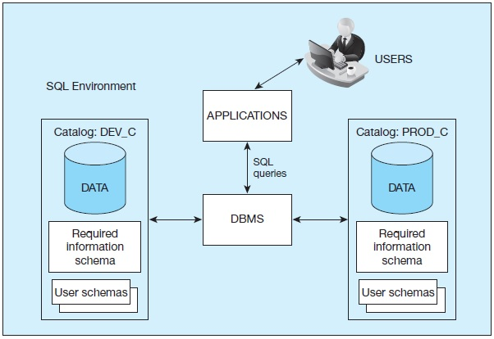
Figure 5-1 S Q L Environment, as Described by the S Q L:2016 Standard
Notes:
A database instance, also called a database server, is a set of memory structure and software processes that manage the access to a set of database files. Each instance maintains one or more databases, organized into catalogs consisting of schemas.
Here we see an instance of a DBMS along with two databases (PROD and DEV). The Production database contains its own data indexed by the catalog PROD_C. It is the actual database being used for business operations. The Development database is used for making application changes and testing. Usually, organizations have two separate databases, one for production and one for development.

Slide 10
SQL Data Types
Strings
CHARACTER (n), VARYING CHARACTER (n)
Binary
Binary Large Object (B L O B)
Number
Numeric (precision, scale), Decimal (p, s), Integer
Temporal
Timestamp, Timestamp with local time zone
Boolean
True or False values

Slide 11
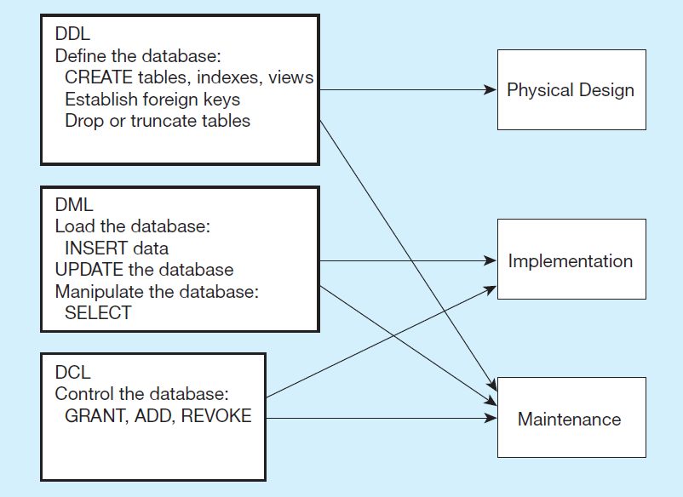
Figure 5-4 D D L, D M L, D C L, and the Database Development Process
Notes:
SQL is composed of three sub-languages, DDL, DML, and DCL.
DDL is Data Definition Language. This is used to actually create the metadata of the database, including all tables, attributes and their data types, indexes, primary and foreign keys, etc. The DDL implements the logical design into actual physical databases. This is the language that database designers will use to create the database.
DML is Data Manipulation Language. This includes all query, update, insert, and delete statements. This is the language that allows users and applications to interact with and manipulate the data in the database.
DCL is Data Control Language. This is used by database administrators to specify who can access the data, and the types of data and operations these users are authorized to manipulate.

Slide 12
S Q L Database Definition
Data Definition Language (D D L)
Major CREATE statements:
CREATE SCHEMA/DATABASE – defines a portion of the database owned by a particular user
CREATE TABLE – defines a new table and its columns
CREATE VIEW – defines a logical table from one or more tables or views
Other CREATE statements: CHARACTER SET, COLLATION, TRANSLATION, ASSERTION, DOMAIN

Slide 13
Steps in Table Creation
Identify data types for attributes
Identify columns that can and cannot be null
Identify columns that must be unique (candidate keys)
Identify primary key–foreign key mates
Determine default values
Identify constraints on columns (domain specifications)
Create the table and associated indexes

Slide 14
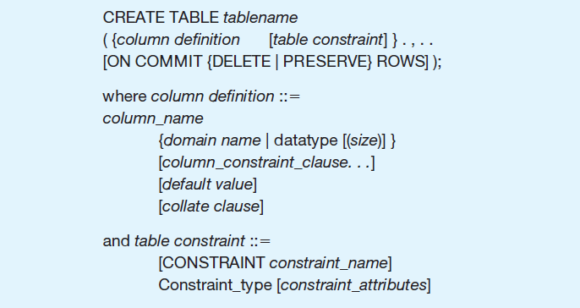
Figure 5-5 General Syntax for CREATE TABLE Statement Used in Data Definition Language
Notes:
This figure shows the overall structure of a CREATE TABLE statement. It shows that the table will have a name, and some number of column definitions and table constraints. In the following slides, we see several examples, related to the Pine Valley Furniture database.

Slide 15
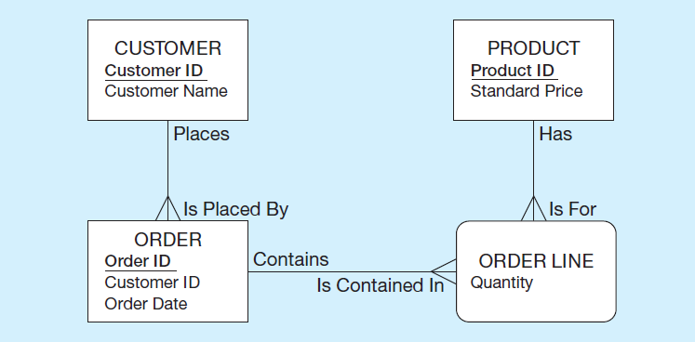
The Following Slides Create Tables for This Enterprise Data Model
(from Chapter 1, Figure 1-3)
Notes:
This is the E-R diagram from chapter 1. Each of these entities, including the associative entity, is implemented as a table in the database.

Slide 16
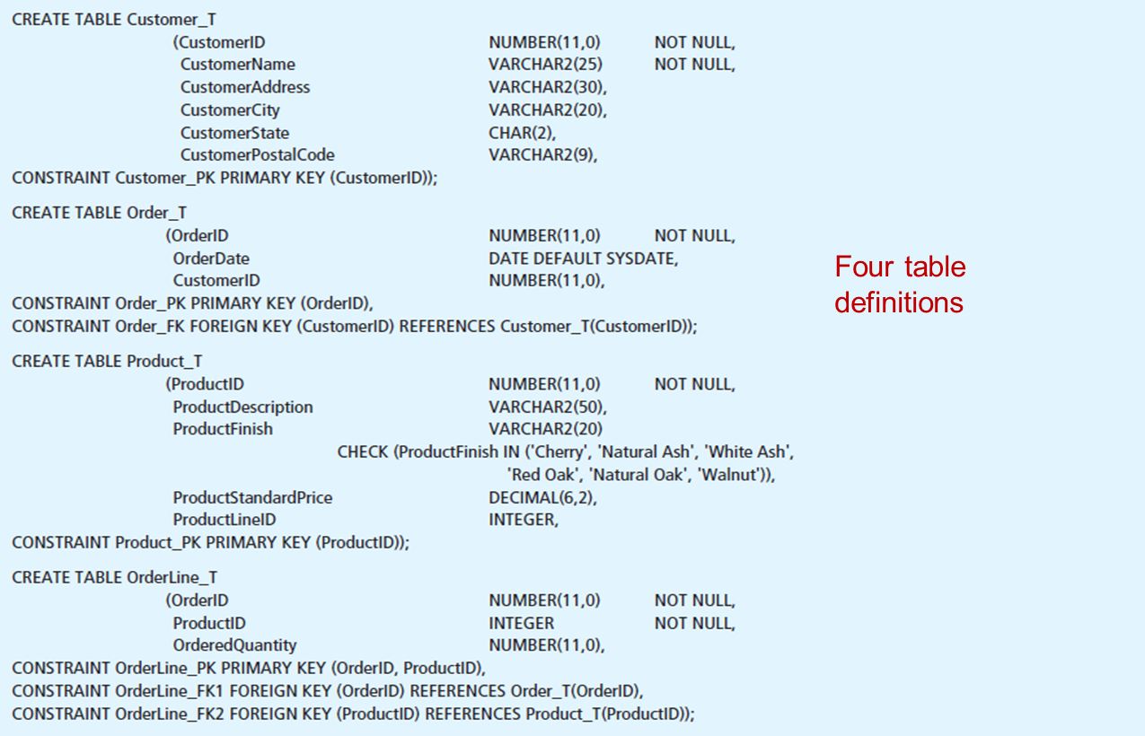
Figure 5-6 S Q L Database Definition Commands for P V F Company (Oracle 12c)
Notes:
Here we see the SQL DDL commands for creating four tables, one each for customer, order, product, and order line. Note that for each of these, there is some number of column definitions and some number of constraints.
Steps to follow when preparing to create a table:
1. Identify the appropriate data type, including length, precision, and scale, if required, for each attribute.
2. Identify the columns that should not accept null values. Column controls that indicate a column cannot be null are established when a table is created and are
enforced for every update of the table when data are entered.
3. Identify the columns that need to be unique. When a column control of UNIQUE is established for a column, the data in that column must have a different value for each row of data within that table (i.e., no duplicate values). Where a column or set of columns is designated as UNIQUE, that column or set of columns is a candidate key, as discussed in Chapter 4. Although each base table may have multiple candidate keys, only one candidate key may be designated as a PRIMARY KEY. When a column(s) is specified as the PRIMARY KEY, that column(s) is also assumed to be NOT NULL, even if NOT NULL is not explicitly stated. UNIQUE and PRIMARY KEY are both column constraints. Note that a table with a composite primary key, OrderLine_T, is defined in Figure 5-6. The OrderLine_PK constraint includes both OrderID and ProductID in the primary key constraint, thus creating a composite key. Additional attributes may be included within the parentheses as needed to create the composite key.
4. Identify all primary key–foreign key connections, as presented in Chapter 4. Foreign keys can be established immediately, as a table is created, or later by altering the table. The parent table in such a parent–child relationship should be created first so that the child table will reference an existing parent table when it is created. The column constraint REFERENCES can be used to enforce referential integrity (e.g., the Order_FK constraint on the Order_T table).
5. Determine values to be inserted in any columns for which a default value is desired. DEFAULT can be used to define a value that is automatically inserted when no value is identified during data entry. In Figure 5-6, the command that creates the Order_T table has defined a default value of SYSDATE (Oracle’s name for the current date) for the OrderDate attribute.
6. Identify any columns for which domain specifications may be stated that are more constrained than those established by data type. Using CHECK as a column constraint, it may be possible to establish validation rules for values to be inserted into the database. In Figure 5-6, creation of the Product_T table includes a check constraint, which lists the possible values for ProductFinish. Thus, even though an entry of ‘White Maple’ would meet the VARCHAR2 data type constraints, it would be rejected because ‘White Maple’ is not in the checklist.
CREATE TABLE statements from Figure 5-6:
CREATE TABLE Customer_T
(CustomerID NUMBER(11,0)
CustomerName VARCHAR2(25)
CustomerAddress VARCHAR2(30),
CustomerCity VARCHAR2(20),
CustomerState CHAR(2),
CustomerPostalCode VARCHAR2(9),
CONSTRAINT Customer_PK PRIMARY KEY (CustomerID));
CREATE TABLE Order_T
(OrderID NUMBER(11,0) NOT NULL,
NOT NULL,
NOT NULL,
OrderDate DATE DEFAULT SYSDATE,
CustomerID NUMBER(11,0),
CONSTRAINT Order_PK PRIMARY KEY (OrderID),
CONSTRAINT Order_FK FOREIGN KEY (CustomerID) REFERENCES Customer_T(CustomerID));
CREATE TABLE Product_T
(ProductID NUMBER(11,0) NOT NULL,
ProductDescription VARCHAR2(50),
ProductFinish VARCHAR2(20)
CHECK (ProductFinish IN ('Cherry', 'Natural Ash', 'White Ash',
'Red Oak', 'Natural Oak', 'Walnut')),
ProductStandardPrice DECIMAL(6,2),
ProductLineID INTEGER,
CONSTRAINT Product_PK PRIMARY KEY (ProductID));
CREATE TABLE OrderLine_T
(OrderID NUMBER(11,0) NOT NULL,
ProductID INTEGER NOT NULL,
OrderedQuantity NUMBER(11,0),
CONSTRAINT OrderLine_PK PRIMARY KEY (OrderID, ProductID),
CONSTRAINT OrderLine_FK1 FOREIGN KEY (OrderID) REFERENCES Order_T(OrderID),
CONSTRAINT OrderLine_FK2 FOREIGN KEY (ProductID) REFERENCES Product_T(ProductID));

Slide 17
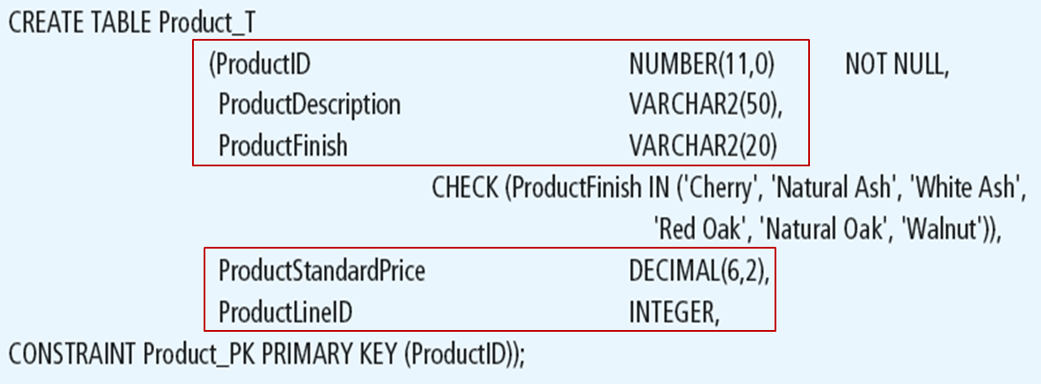
Defining Attributes and Their Data Types
Notes:
Each column has a data type. In this case, some are numeric, and some are character (text). You can also specify column sizes. For numeric columns, you can specify whether they will be integer (which ProductID is) or allow decimal values (such as ProductStandardPrice).

Slide 18
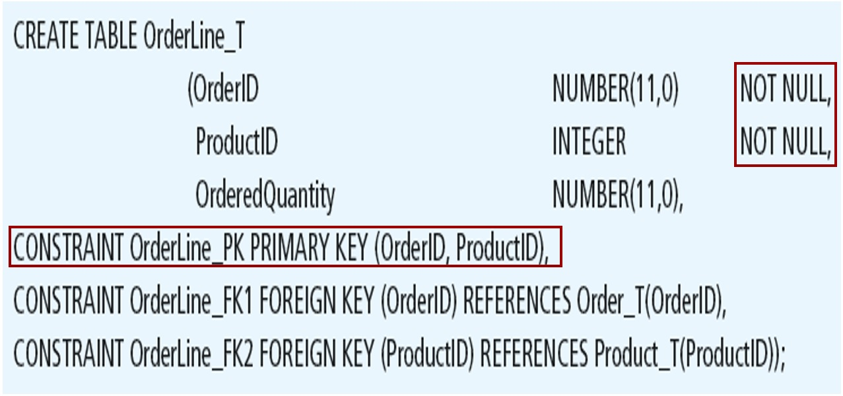
Non-Nullable Specifications
Some primary keys are composite– composed of multiple attributes
Notes:
For this table, we see a composite primary key.
Remember that OrderLine is an associative entity, between Product and Order. Therefore it has two foreign keys, one to each of these tables.

Slide 19
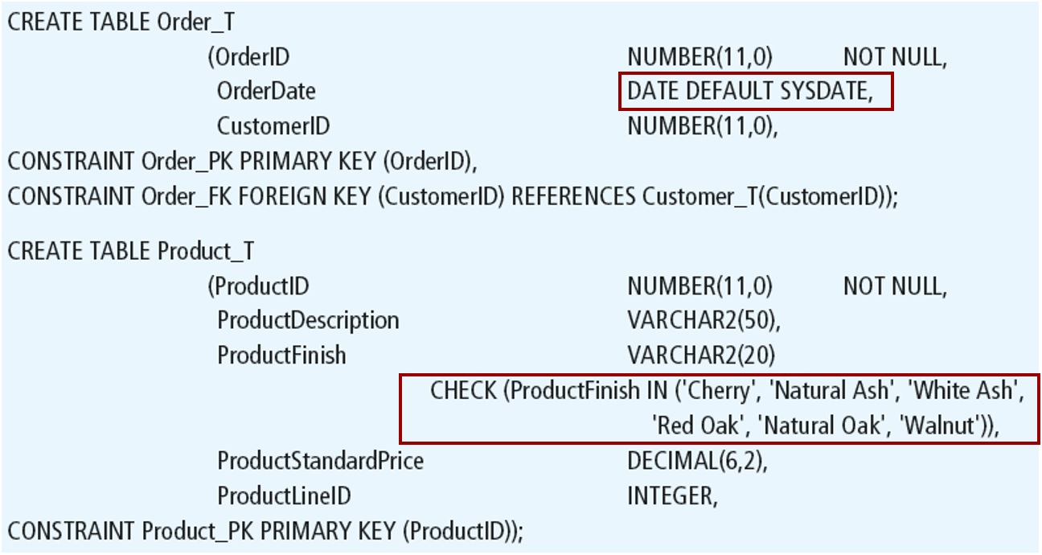
Controlling the Values in Attributes
Notes:
Here we see a domain constraint that limits the number of allowable values for the ProductFinish column. The CHECK operator always ensures that update and insert attempts to this table will only allow the values listed. However, because ProductFinish does not prohibit null values, it is possible to insert a record while leaving ProductFinish without a value at all.
We also see a default value for OrderDate, which is SYSDATE. SYSDATE is the current date. So, if a new order record is created and the order date is not explicitly entered, then it defaults to the current date at the time the record is created (via an INSERT statement).

Slide 20
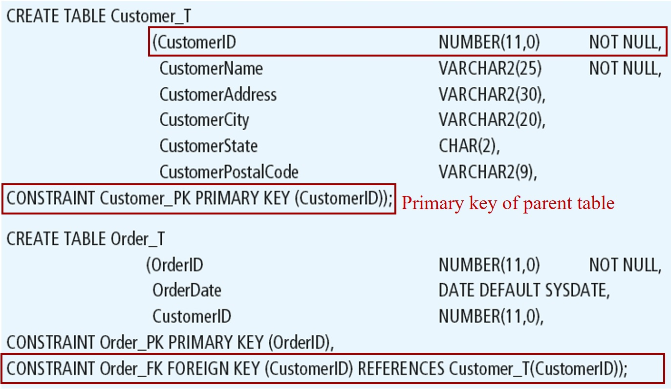
Identifying Foreign Keys and Establishing Relationships
Notes:
Here we see that the Order table has a foreign key. This CONSTRAINT statement creates a foreign key constraint, referencing the Customer table’s primary key.

Slide 21
Data Integrity Controls
Referential integrity – constraint that ensures that foreign key values of a table must match primary key values of a related table in
relationships
Restricting:
Deletes of primary records
Updates of primary records
Inserts of dependent records

Slide 22
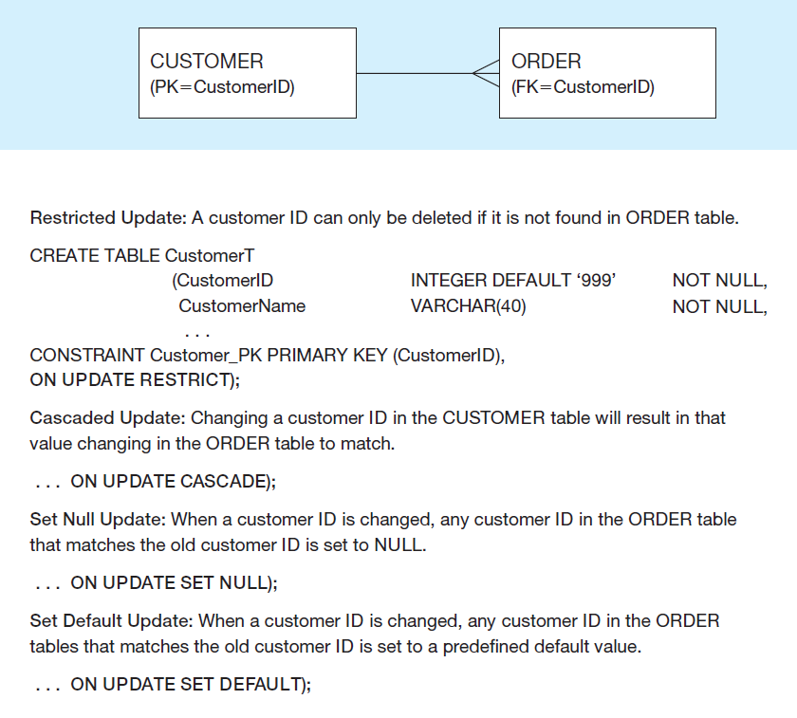
Figure 5-7 Ensuring Data Integrity Through Updates
Relational integrity is enforced via the primary-key to foreign-key match
Notes:
The CREATE TABLE statement includes a clause to specify how updates and deletes are processed when there are dependent tables. If a DELETE request comes for a record with dependent records in another table, the DBMS could restrict the delete, which means to disallow it. Or, it could cascade the delete, so that dependent records with matching foreign keys will also be deleted. Or it could set null, which means that deleting the primary key record will result in setting all corresponding foreign keys to be set to null (this would imply an optional one cardinality in the relationship).

Slide 23
SQL Practice Instruction
It is expected that you are now using XAMPP/Workbench to write MySQL code
Please go to page 41 of your textbook/Figure 1-17.
Create a database to your choice
Create four tables shown in the figure mentioned above and insert records to corresponding tables.
Use the EXPORT tool to export your database (includes all tables and records) for backup. You should get a file with an extension .sql (myfirst_database.sql)

Slide 24

Copyright

